Slide 1
Chapter 10: Virtual Memory

Slide 2
Chapter 10: Virtual Memory
Background
Demand Paging
Page Replacement
Allocation of Frames
Thrashing
Allocating Kernel Memory

Slide 3
Virtual memory
Virtual memory – separation of user logical memory from physical memory
  Only part of the program needs to be in memory for execution
  Logical address space can therefore be much larger than physical address space
  Allows address spaces to be shared by several processes
  Allows for more efficient process creation
  More programs running concurrently
  Less I/O needed to load or swap processes

Slide 4
Virtual memory (Cont.)
Virtual address space – logical view of how process is stored in memory
  Usually start at address 0, contiguous addresses until end of space
  Meanwhile, physical memory organized in page frames
  MMU must map logical to physical
Virtual memory can be implemented via:
  Demand paging
  Demand segmentation

Slide 5
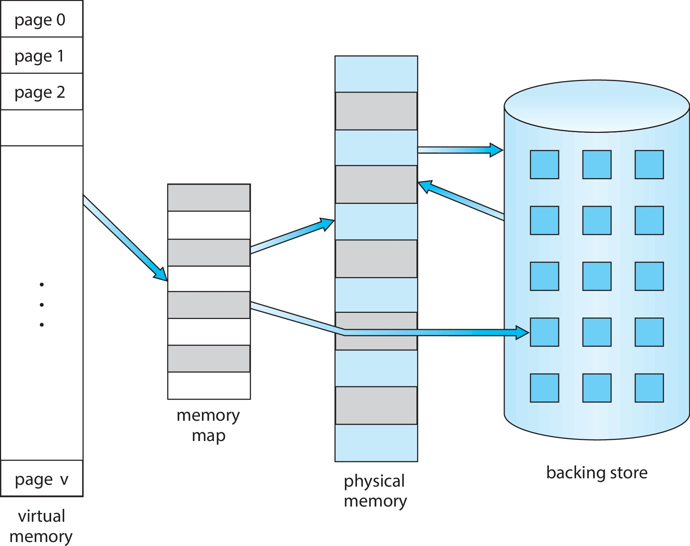
Virtual Memory That is Larger Than Physical Memory

Slide 6

Virtual-address Space
Usually design logical address space for stack to start at Max logical address and grow “down” while heap grows “up”
  Maximizes address space use
  Unused address space between the two is hole
    No physical memory needed until heap or stack grows to a given new page
System libraries shared via mapping into virtual address space
Shared memory by mapping pages read-write into virtual address space
Pages can be shared during fork(), speeding process creation

Slide 7

Shared Library Using Virtual Memory

Slide 8

Demand Paging
Could bring entire process into memory at load time
Or bring a page into memory only when it is needed
  Less I/O needed, no unnecessary I/O
  Less memory needed
  Faster response
  More users
Similar to paging system with swapping (diagram on right)

Slide 9

Valid-Invalid Bit
With each page table entry a valid–invalid bit is associated
(v ⇒ in-memory – memory resident, i ⇒ not-in-memory)
Initially valid–invalid bit is set to i on all entries
Example of a page table snapshot:
During MMU address translation, if valid–invalid bit in page table entry is i ⇒ page fault

Slide 10
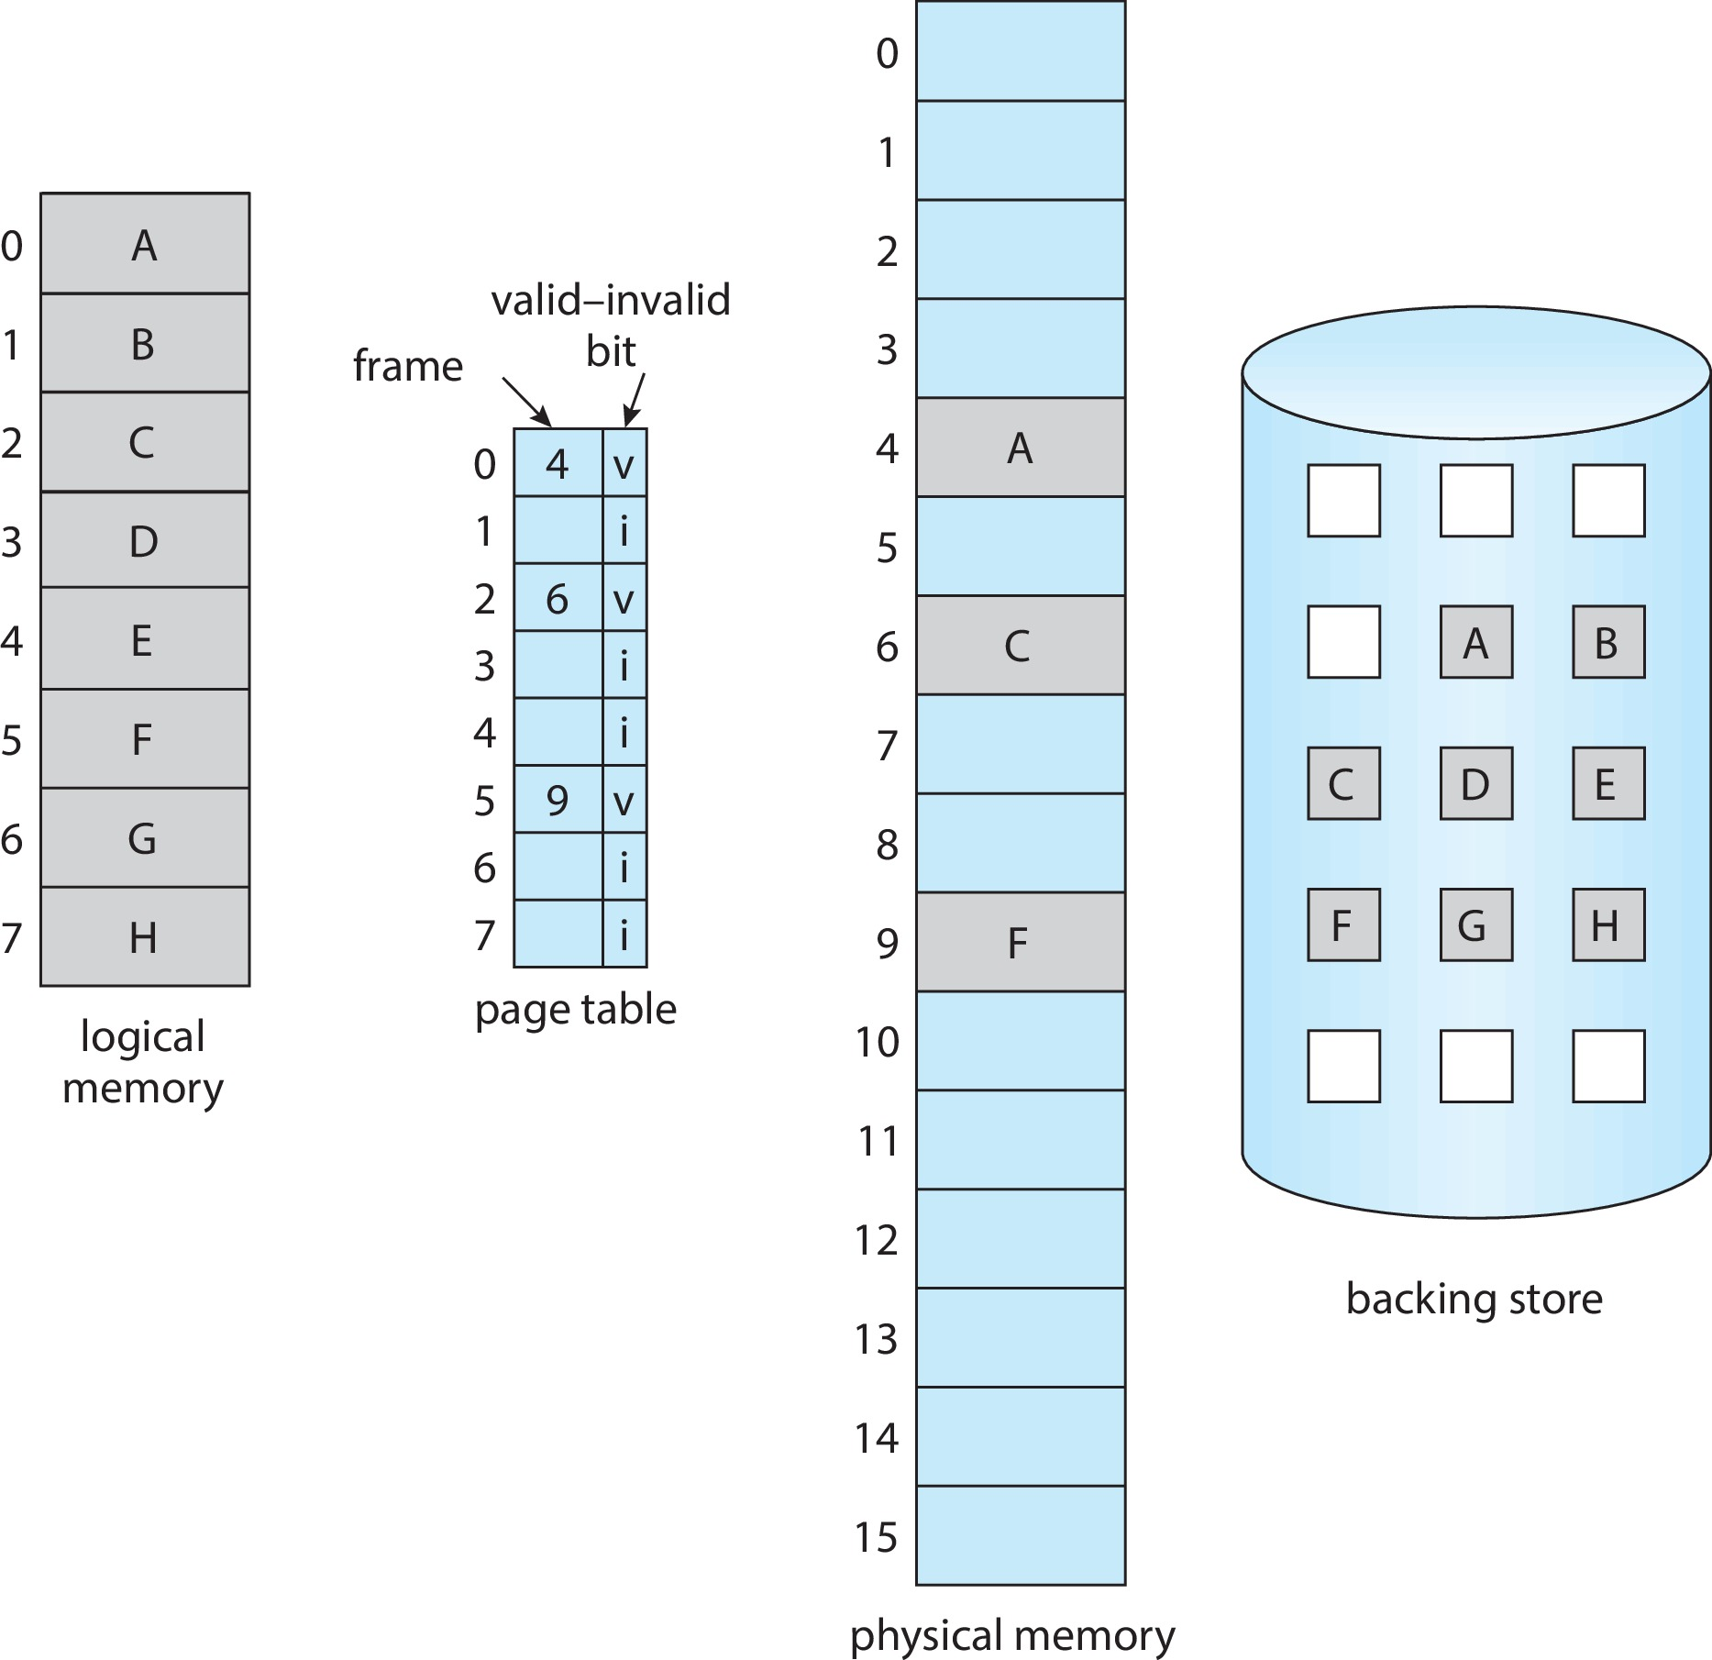
Page Table When Some Pages Are Not in Main Memory

Slide 11
Steps in Handling Page Fault
If there is a reference to a page, first reference to that page will trap to operating system
  Page fault
Operating system looks at another table to decide:
  Invalid reference ⇒ abort
  Just not in memory
Find free frame
Swap page into frame via scheduled disk operation
Reset tables to indicate page now in memory
Set validation bit = v
Restart the instruction that caused the page fault

Slide 12

Steps in Handling a Page Fault (Cont.)

Slide 13
Aspects of Demand Paging
Extreme case – start process with no pages in memory
  OS sets instruction pointer to first instruction of process, non-memory-resident -> page fault
  And for every other process pages on first access
  Pure demand paging： never bring a page into memory until it is required
Actually, a given instruction could access multiple pages -> multiple page faults
  Consider fetch and decode of instruction which adds 2 numbers from memory and stores result back to memory
  Pain decreased because of locality of reference
Hardware support needed for demand paging
  Page table with valid / invalid bit
  Secondary memory (swap device with swap space)
  Instruction restart

Slide 14
Free-Frame List
When a page fault occurs, the OS must bring the desired page from secondary storage into main memory.
Most OSes maintain a free-frame list -- a pool of free frames for satisfying such requests.
When a system starts up, all available memory is placed on the free-frame list.

Slide 15
Stages in Demand Paging – Worse Case
Trap to the OS
Save the user registers and process state
Determine that the interrupt was a page fault
Check that the page reference was legal and determine the location of the page on the disk
Issue a read from the disk to a free frame:
  Wait in a queue for this device until the read request is serviced
  Wait for the device seek and/or latency time
  Begin the transfer of the page to a free frame

Slide 16
Stages in Demand Paging (Cont.)
While waiting, allocate the CPU to some other user
Receive an interrupt from the disk I/O subsystem (I/O completed)
Save the registers and process state for the other user
Determine that the interrupt was from the disk
Correct the page table and other tables to show page is now in memory
Wait for the CPU to be allocated to this process again
Restore the user registers, process state, and new page table, and then resume the interrupted instruction

Slide 17
Performance of Demand Paging
Three major activities
  Service the interrupt – careful coding means just several hundred instructions needed
  Read the page – lots of time
  Restart the process – again just a small amount of time
Page Fault Rate 0 ≤ p ≤ 1
  if p = 0 no page faults
  if p = 1, every reference is a fault
Effective Access Time (EAT)
EAT = (1 – p) x memory access
+ p (page fault overhead
+ swap page out
+ swap page in )

Slide 18
Demand Paging Example
Memory access time = 200 nanoseconds
Average page-fault service time = 8 milliseconds
EAT = (1 – p) x 200 + p (8 milliseconds)
= (1 – p) x 200 + p x 8,000,000
= 200 + p x 7,999,800
If one access out of 1,000 causes a page fault, then
EAT = 8.2 microseconds.
This is a slowdown by a factor of 40 !
If want performance degradation < 10 percent
  220 > 200 + 7,999,800 x p
  20 > 7,999,800 x p
  p < .0000025
  < one page fault in every 400,000 memory accesses

Slide 19
Demand Paging Optimizations
Swap space I/O faster than file system I/O even if on the same device
  Swap allocated in larger chunks, less management needed than file system
Demand page in from program binary on disk, but discard rather than paging out when freeing frame
  Used in Solaris and current BSD
  Still need to write to swap space
    Pages not associated with a file (like stack and heap) – anonymous memory
    Pages modified in memory but not yet written back to the file system
Mobile systems
  Typically don’t support swapping
  Instead, demand page from file system and reclaim read-only pages (such as code)

Slide 20
Copy-on-Write
Copy-on-Write (COW) allows both parent and child processes to initially share the same pages in memory
  If either process modifies a shared page, only then is the page copied
COW allows more efficient process creation as only modified pages are copied
vfork() variation on fork() system call has parent suspend and child using copy-on-write address space of parent
  Designed to have child call exec()
  Very efficient

Slide 21

Before Process 1 Modifies Page C

Slide 22

After Process 1 Modifies Page C

Slide 23
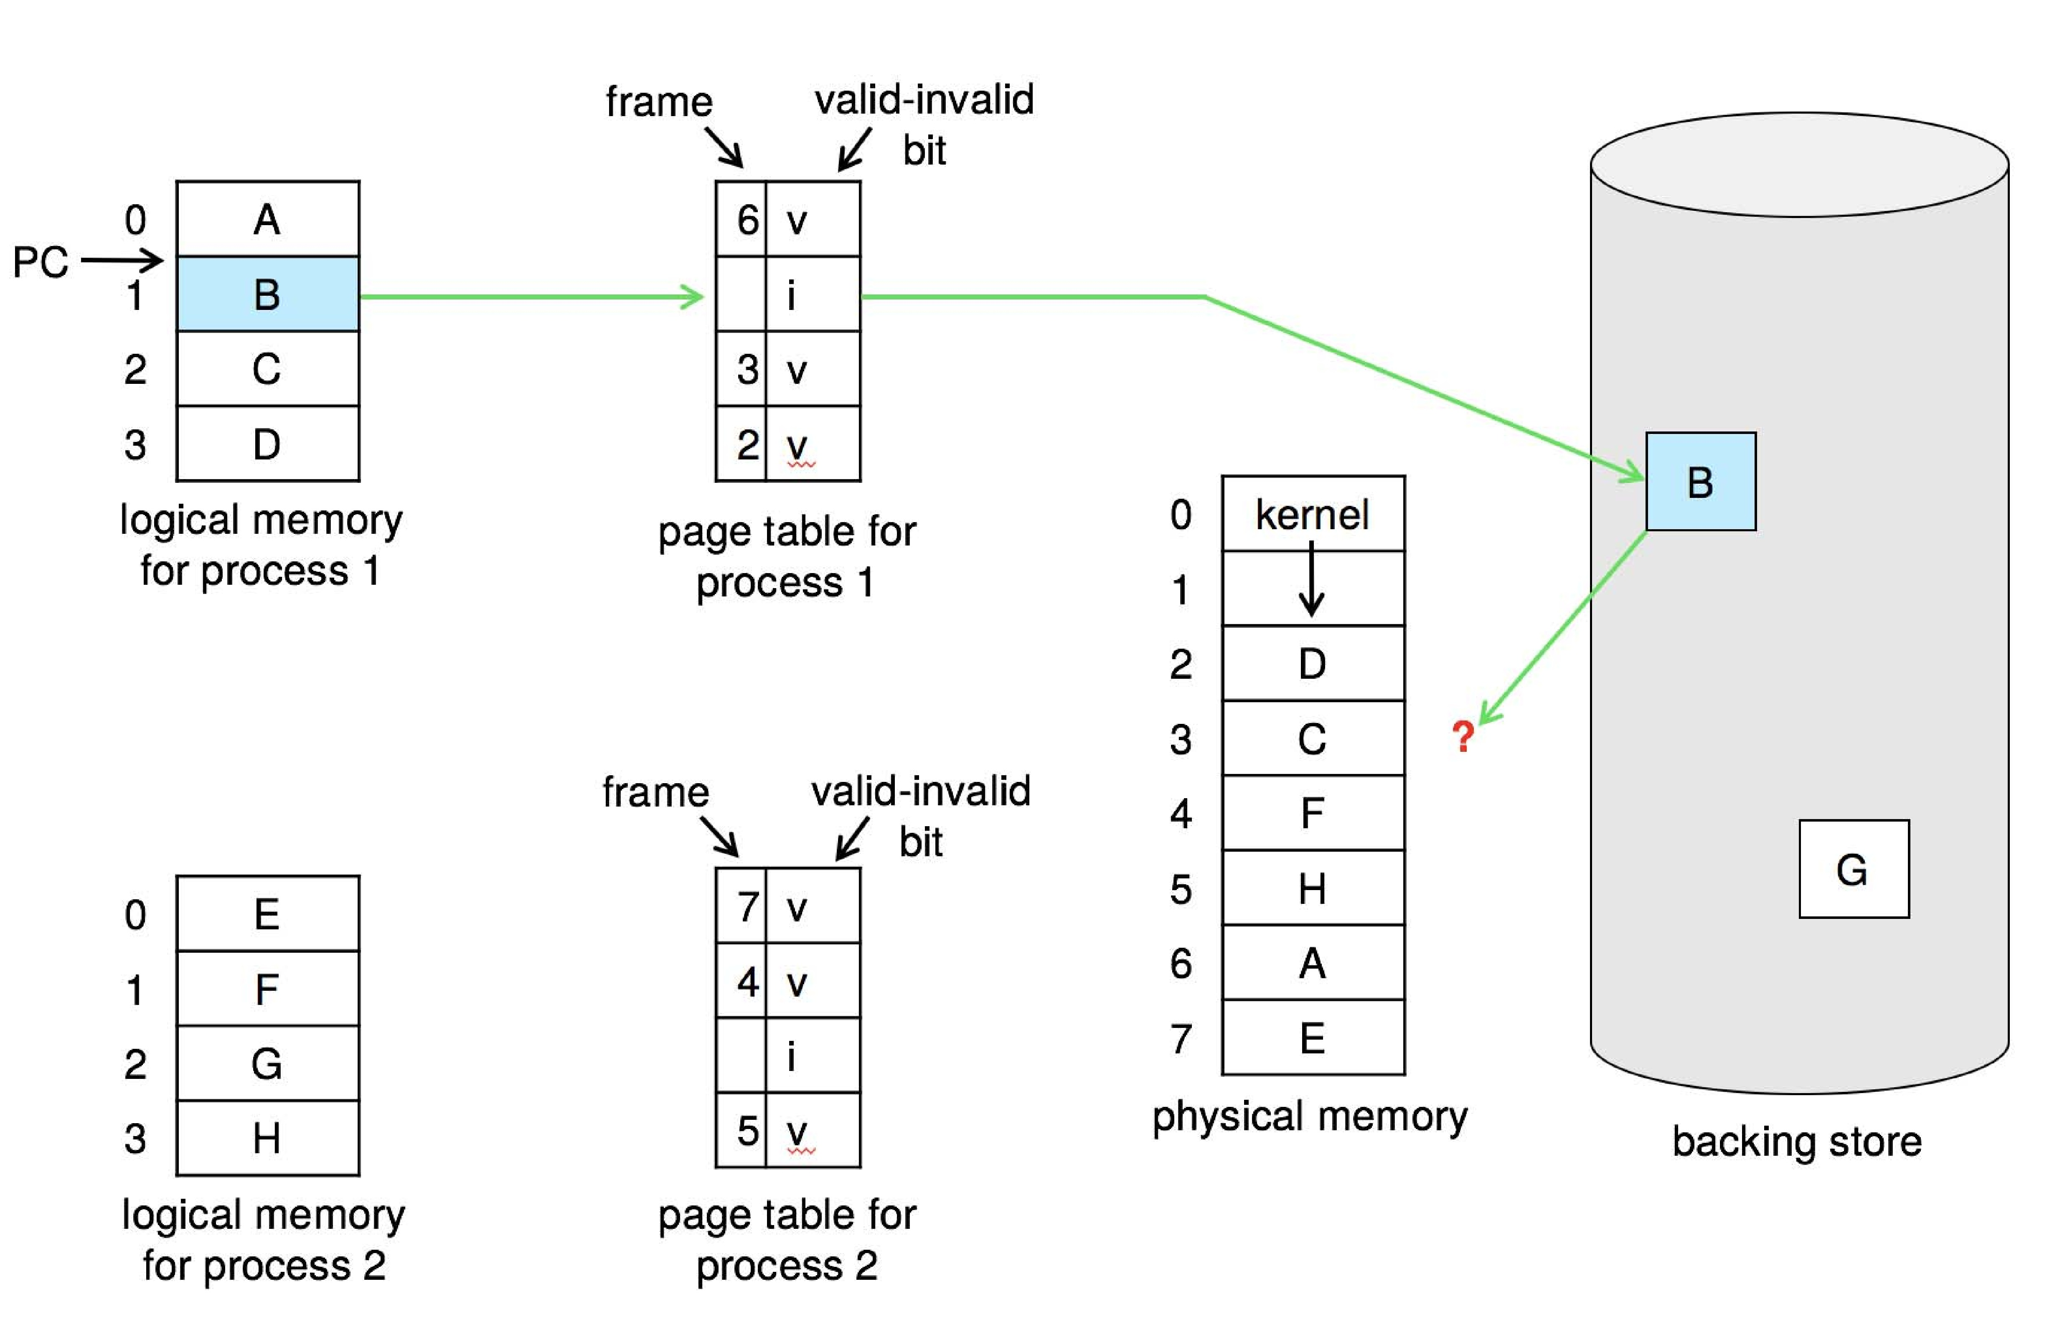
What Happens if There is no Free Frame?
Used up by process pages, also in demand from the kernel, I/O buffers, etc
How much to allocate to each? -- need for page replacement
  Find some page in memory, but not really in use, page it out

Slide 24
Basic Page Replacement
Find the location of the desired page on disk
Find a free frame:
- If there is a free frame, use it
- If there is no free frame, use a page replacement algorithm to select a victim frame
- Write victim frame to disk if dirty
Bring the desired page into the (newly) free frame; update the page and frame tables
Continue the process by restarting the instruction that caused the trap
Note now potentially 2 page transfers for page fault – increasing EAT

Slide 25

Page Replacement

Slide 26
Page and Frame Replacement Algorithms
Page-replacement algorithm
  Want lowest page-fault rate on both first access and re-access
Evaluate algorithm by running it on a particular string of memory references (reference string) and computing the number of page faults on that string
  String is just page numbers
In all our examples, the reference string of referenced page numbers is
7,0,1,2,0,3,0,4,2,3,0,3,0,3,2,1,2,0,1,7,0,1

Slide 27

First-In-First-Out (FIFO) Algorithm
Reference string: 7,0,1,2,0,3,0,4,2,3,0,3,0,3,2,1,2,0,1,7,0,1
3 frames (3 pages can be in memory at a time per process)
Can vary by reference string: consider 1,2,3,4,1,2,5,1,2,3,4,5
  Adding more frames can cause more page faults!
    Belady’s Anomaly
How to track ages of pages?
  Just use a FIFO queue
15 page faults

Slide 28

FIFO Illustrating Belady’s Anomaly

Slide 29

Optimal Algorithm
Replace page that will not be used for longest period of time
  9 is optimal for the example
How do you know this?
  Can’t read the future
Used for measuring how well your algorithm performs

Slide 30

Least Recently Used (LRU) Algorithm
Use past knowledge rather than future
Replace page that has not been used in the most amount of time
Associate time of last use with each page
12 faults – better than FIFO but worse than OPT
Generally good algorithm and frequently used
But how to implement?

Slide 31
LRU Algorithm (Cont.)
Counter implementation
  Every page entry has a counter; every time page is referenced through this entry, copy the clock into the counter
  When a page needs to be changed, look at the counters to find smallest value
    Search through table needed
Stack implementation
  Keep a stack of page numbers in a double link form:
  Page referenced:
    move it to the top
    requires 6 pointers to be changed
  But each update more expensive
  No search for replacement
LRU and OPT are cases of stack algorithms that don’t have Belady’s Anomaly

Slide 32
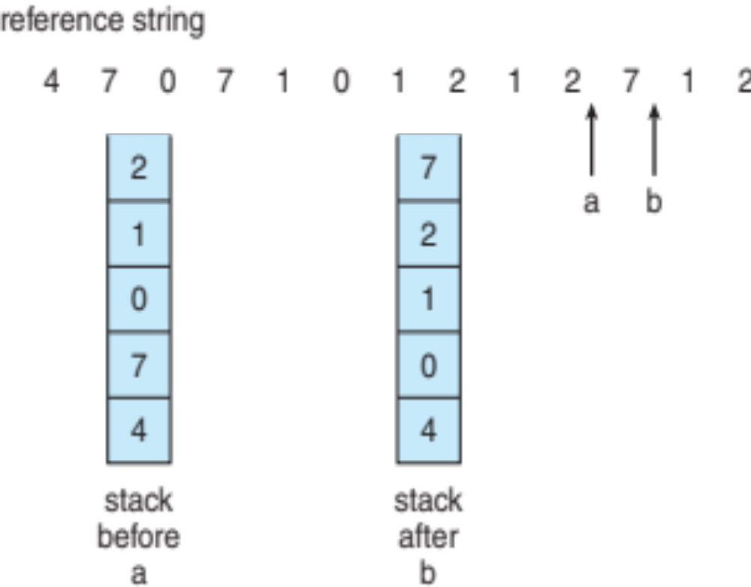
Use Of A Stack to Record Most Recent Page References

Slide 33
LRU Approximation Algorithms
LRU needs special hardware and still slow
Reference bit
  With each page associate a bit, initially = 0
  When page is referenced, bit set to 1
  Replace any with reference bit = 0 (if one exists)
    We do not know the order, however
Second-chance algorithm
  Generally FIFO, plus hardware-provided reference bit
  Clock replacement
  If page to be replaced has
    Reference bit = 0 -> replace it
    reference bit = 1 then:
      set reference bit 0, leave page in memory
      replace next page, subject to same rules

Slide 34

Second-Chance (clock) Page-Replacement Algorithm

Slide 35
Allocation of Frames
Each process needs minimum number of frames
Example: IBM 370 – 6 pages to handle SS MOVE instruction:
  instruction is 6 bytes, might span 2 pages
  2 pages to handle from
  2 pages to handle to
Maximum of course is total frames in the system
Two major allocation schemes
  fixed allocation
  priority allocation
Many variations

Slide 36


Fixed Allocation
Equal allocation – For example, if there are 100 frames (after allocating frames for the OS) and 5 processes, give each process 20 frames
  Keep some as free frame buffer pool
Proportional allocation – Allocate according to the size of process
  Dynamic as degree of multiprogramming, process sizes change

Slide 37
Global vs. Local Allocation
Global replacement – process selects a replacement frame from the set of all frames; one process can take a frame from another
  But then process execution time can vary greatly
  But greater throughput so more common
Local replacement – each process selects from only its own set of allocated frames
  More consistent per-process performance
  But possibly underutilized memory

Slide 38
Reclaiming Pages
A strategy to implement global page-replacement policy
All memory requests are satisfied from the free-frame list, rather than waiting for the list to drop to zero before we begin selecting pages for replacement,
Page replacement is triggered when the list falls below a certain threshold.
This strategy attempts to ensure there is always sufficient free memory to satisfy new requests.

Slide 39
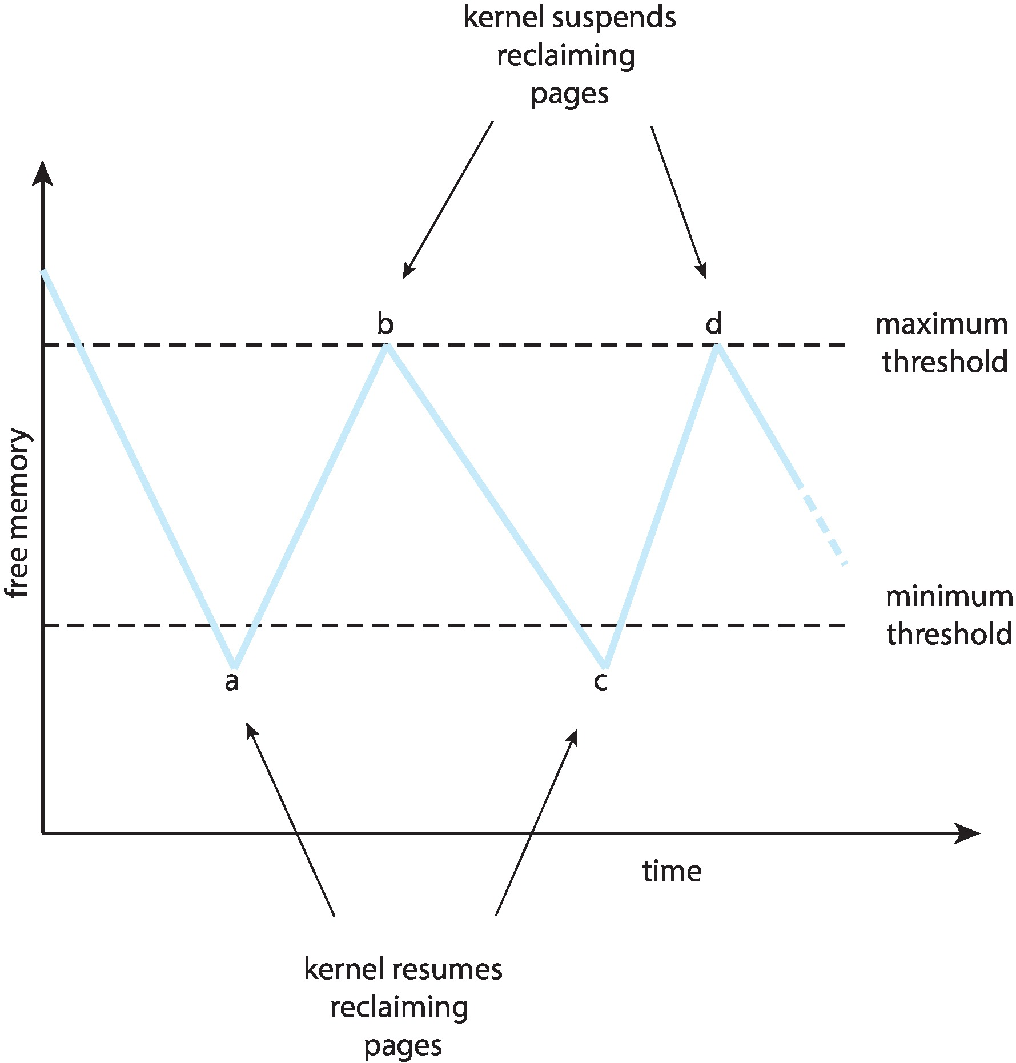
Reclaiming Pages Example

Slide 40
Out-of-memory (OOM) killer
When the amount of free memory falls to very low levels
In Linux, A routine known as the out-of-memory (OOM) killer selects a process to terminate, thereby freeing its memory
Each process has an OOM score
  Higher -> more likely to get killed
Calculated according to the percentage of memory a process is using
  higher percentage -> higher OOM score.
Can be viewed in the /proc file system
  the score for a process with pid 2500 is in /proc/2500/oom_score

Slide 41
Thrashing
If a process does not have “enough” pages, the page-fault rate is very high
  Page fault to get page
  Replace existing frame
  But quickly need replaced frame back
  This leads to:
    Low CPU utilization
    OS thinks that it needs to increase the degree of multiprogramming
    Another process added to the system

Slide 42
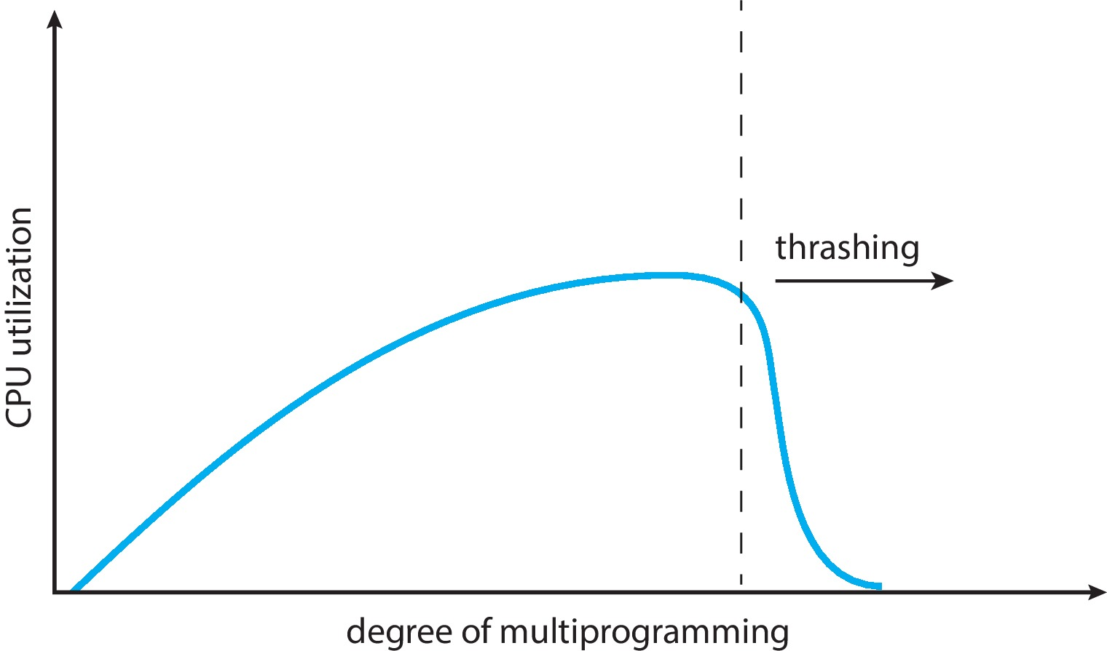
Thrashing (Cont.)
Thrashing. A process is busy swapping pages in and out

Slide 43
Demand Paging and Thrashing
Why does demand paging work?
Locality model
  Process migrates from one locality to another
  Localities may overlap
Why does thrashing occur?
Σ size of locality > total memory siz
Limit effects by using local or priority page replacement
  Does not solve the problem entirely
To prevent thrashing, we must provide a process with as many frames as it needs. But how do we know how many frames it “needs”?
One strategy starts by looking at how many frames a process is recently using.

Slide 44
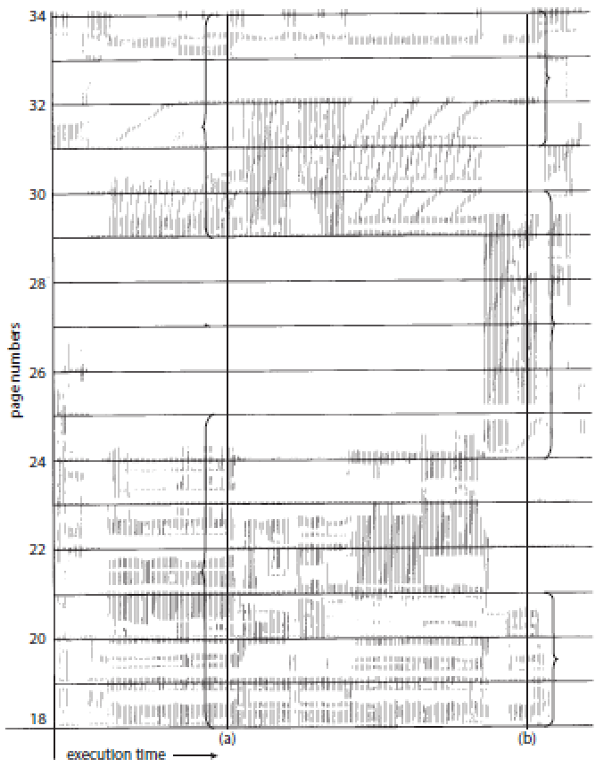
Locality In A Memory-Reference Pattern
As a process executes, it moves from locality to locality.
A locality is a set of pages that are actively used together

Slide 45

Working-Set Model
An approximation of the program’s locality
Δ ≡ working-set window ≡ a fixed number of page references
Example: 10,000 instructions
WSS_{i} (working set of Process P_{i}) = total number of pages referenced in the most recent Δ (varies in time)
  if Δ too small will not encompass entire locality
  if Δ too large will encompass several localities
  if Δ = ∞ ⇒ will encompass entire program
D = Σ WSS_{i} ≡ total demand frames; if > available memory m, i. e.,
  if D > m ⇒ Thrashing, need suspend or swap out one of the processes

Slide 46

Page-Fault Frequency
More direct and cheaper approach than WSS
Establish “acceptable” page-fault frequency (PFF) rate and use local replacement policy
  If actual rate too low, process loses frame
  If actual rate too high, process gains frame

Slide 47

Working Sets and Page Fault Rates
Direct relationship between working set of a process and its page-fault rate
Working set changes over time
Peaks and valleys over time

Slide 48
Allocating Kernel Memory
Treated differently from user memory
Often allocated from a free-memory pool
  Kernel requests memory for structures of varying sizes
  Some kernel memory needs to be contiguous
    I.e. for device I/O

Slide 49
Buddy System
Allocates memory from fixed-size segment consisting of physically-contiguous pages
Memory allocated using power-of-2 allocator
  Satisfies requests in units sized as power of 2
  Request rounded up to next highest power of 2
  When smaller allocation needed than is available, current chunk split into two buddies of next-lower power of 2
    Continue until appropriate sized chunk available
For example, assume 256KB chunk available, kernel requests 21KB
  Split into A_{L} _{and} A_{R} of 128KB each
    One further divided into B_{L} and B_{R} of 64KB
      One further into C_{L} and C_{R} of 32KB each – one used to satisfy request
Advantage – quickly coalesce unused chunks into larger chunk
Disadvantage - fragmentation

Slide 50

Buddy System Allocator

Slide 51
Slab Allocator
Alternate strategy
Slab is one or more physically contiguous pages
Cache consists of one or more slabs
Single cache for each unique kernel data structure
  Each cache filled with objects – instantiations of the data structure
When cache created, filled with objects marked as free
When structures stored, objects marked as used
If slab is full of used objects, next object allocated from empty slab
  If no empty slabs, new slab allocated
Benefits include no fragmentation, fast memory request satisfaction

Slide 52

Slab Allocation

Slide 53
Slab Allocator in Linux
For example process descriptor is of type struct task_struct
Approx 1.7KB of memory
New task -> allocate new struct from cache
  Will use existing free struct task_struct
Slab can be in three possible states
  Full – all used
  Empty – all free
  Partial – mix of free and used
Upon request, slab allocator
  Uses free struct in partial slab
  If none, takes one from empty slab
  If no empty slab, create new empty

Slide 54
End of Chapter 10

